Slide 1

Standard Exercises

Slide 2
Recap...
Functions
Functions help in writing less code (i.e. code reuse)
A function should be defined before it is used
Functions, once defined can be used how many times necessary
For a function, only the input and output matters, internal mechanisms can be ignored
Functions are neat way to divide a big code into smaller chunks

Slide 3
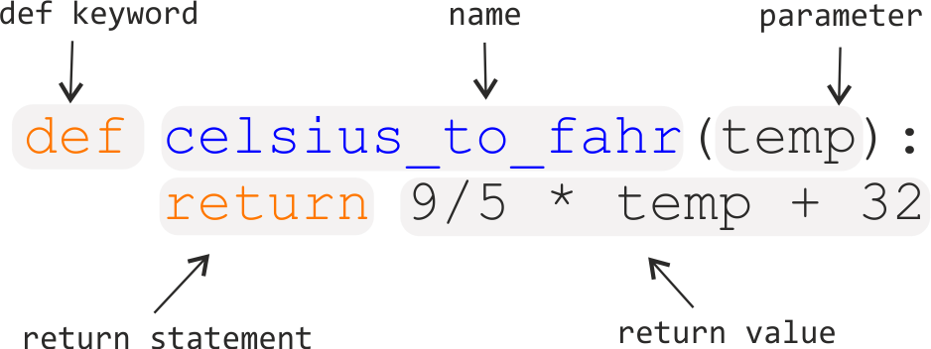
Recap...
Functions

Slide 4
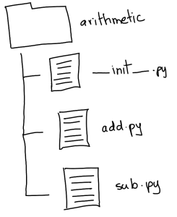
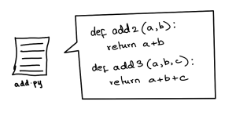
Modules and Packages
Modules are simply python files other than the calling file
Packages are folders containing python modules

Slide 5



Import statement...
What?
Modules provided by python e.g math, datetime, re, random etc.
Modules created by the programmer
Modules created by a third-party (downloaded from the internet)
How can i use import?
How can i use import?
OR
How to use math functions now
How to use math functions now
For complete reference: https://docs.python.org/3/py-modindex.html

Slide 6
Debugging
To remove errors from your code
To inspect your code
One of the most important part of software development
More or less like this:

Slide 7
Exercises
The exercises are present in /Exercises folder
You can download it and Open it in VS Code
Each exercise is in a python file where the problem description and necessary functions are available
When done with a problem, you can also press “F5” key to run the program
If you’re stuck with a problem, refer to the presentations or use python docs.

